Slide 1


T1911
Container Adapters
A Quest Global Company
05/06/2025

Slide 2
Agenda
Topics Covered Today
Key Learnings / Concepts Understood:
Key Concepts with Definitions/ Code Snippet – Hands-on Practice
Challenges / Debugging Experience
Tasks/Assignments Completed
Additional Learning Resources / Notes
Q&A
Plan for Tomorrow

Slide 3
Topics Covered Today
Container Adapters
Stack
Queue
Priority Queue

Slide 4
Key Learnings/Concepts Understood
Container Adapters provide a simplified, specific interface over existing containers (e.g., vector, deque, list).
They act as wrappers adapting underlying containers to serve particular data structure purposes.
The C++ Standard Template Library (STL) includes three main container adapters:
Stack (std::stack) — provides LIFO (last-in, first-out) behavior.
Queue (std::queue) — provides FIFO (first-in, first-out) behavior.
Priority Queue (std::priority_queue) — provides access to the largest element first (max-heap behavior).
Container adapters restrict access to only specific operations relevant to their interface (e.g., push/pop for stack).
They internally use sequence containers like std::deque by default but can be configured to use vector or list.
Container adapters do not support iterators or random access directly.
They simplify container usage by hiding unnecessary operations and enforcing usage patterns.
Used in ADAS for managing ordered tasks like event processing, message buffering, and priority-based decision making.

Slide 5
Stack
A stack is a container adapter in C++ that implements the Last In, First Out (LIFO) principle. Elements are added and removed from the same end, known as the "top" of the stack. The std::stack is designed for scenarios where you need restricted access to the container: only the most recently added element can be accessed or removed.
Why Use std::stack?
LIFO Data Management:
Ideal for tasks that require processing elements in reverse order of their arrival.
Simplified Interface:
Focused on basic stack operations: push, pop, and top, providing an easy-to-use abstraction.
Underlying Container Flexibility:
Allows selection of an underlying container (std::deque, std::vector, or std::list) to meet specific performance needs.
Common Applications:
Parsing and evaluating expressions.
Implementing function call stacks in compilers.
Backtracking algorithms like Depth-First Search (DFS).

Slide 6
Stack
A stack is a container adapter that follows LIFO (Last-In, First-Out) principle.
Common stack operations include:
push(element): Adds an element to the top of the stack.
pop(): Removes the top element from the stack.
top(): Accesses the top element without removing it.
empty(): Checks if the stack is empty.
size(): Returns the number of elements in the stack.
Only the top element is accessible at any time, enforcing strict LIFO access.
Push and pop operations typically have constant time complexity (O(1)).
Stack operations rely on the underlying container (default is std::deque).
Used in ADAS for managing state history, undo mechanisms, and recursive algorithm implementations.

Slide 7
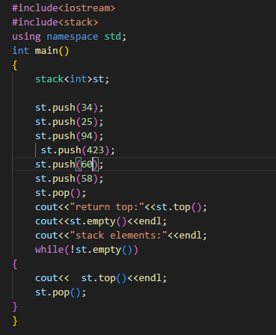
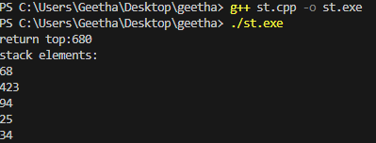
Stack
Example: output:

Slide 8
Queue
A queue is a container adapter in C++ that implements the First In, First Out (FIFO) principle. Elements are inserted at the back and removed from the front. The std::queue provides a simple interface for managing FIFO data structures, making it suitable for applications where sequential processing is required.
Why Use std::queue in C++?
First-In, First-Out (FIFO) Order: Ensures that elements are processed in the exact order they were added — ideal for orderly task handling.
Straightforward Operation Set: Offers just the essential functions:
push(): to add to the back
pop() : to remove from the front
front(): to access the first element
back(): to access the last element
Practical Use Cases:
Managing task queues or job pipelines
Implementing Breadth-First Search (BFS) in algorithms
Handling events or buffering data in real-time systems

Slide 9
Queue
Operation | Description | Syntax Example | Returns | Time Complexity | Notes
push() | Inserts an element at the back | q.push(10); | void | O(1) | Adds new element to the end of the queue
pop() | Removes the element at the front | q.pop(); | void | O(1) | Does not return value; use front() first
front() | Accesses the front element | q.front(); | Reference to front | O(1) | Undefined behavior if queue is empty
back() | Accesses the last (back) element | q.back(); | Reference to back | O(1) | Also check empty() before calling
empty() | Checks if the queue is empty | q.empty(); | true or false | O(1) | Useful before accessing front() or back()
size() | Returns the number of elements | q.size(); | std::size_t | O(1) | Returns current element count in the queue

Slide 10
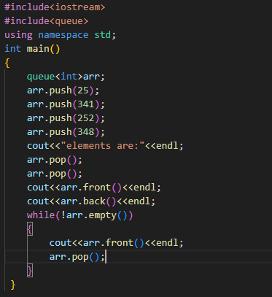
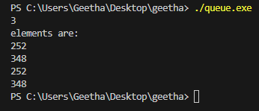
Sequence Containers
Example:-
Output:-

Slide 11
Priority Queue
A priority queue in C++ is a container adapter that arranges elements based on their priority. Unlike a regular queue, where the order of insertion determines the order of removal, a std::priority_queue always ensures that the element with the highest priority (default: largest value) is at the front and is removed first.
By default, std::priority_queue is implemented as a max-heap, but it can be customized for other priority orders using comparators
Benefits of Using std::priority_queue in C++
Access Highest Priority Instantly: Always keeps the element with the highest priority at the top, enabling constant-time access with top().
Automatic Order Maintenance: Internally uses a heap (by default, a max-heap) to dynamically sort elements as they are added or removed.
Flexible Priority Rules: You can define custom comparators to switch from max-heap to min-heap or apply custom ordering logic.
Ideal for High-Priority Task Handling:
Great for task scheduling where more important jobs should execute first.
Used in graph algorithms like Dijkstra’s and A* for efficiently selecting the next best node.
Essential in event-driven systems where events are triggered based on urgency or importance.

Slide 12
Priority Queue
Operation | Description | Syntax Example | Returns | Time Complexity | Notes
push() | Inserts an element at the back | q.push(10); | void | O(1) | Adds new element to the end of the queue
pop() | Removes the element at the front | q.pop(); | void | O(1) | Does not return value; use front() first
front() | Accesses the front element | q.front(); | Reference to front | O(1) | Undefined behavior if queue is empty
back() | Accesses the last (back) element | q.back(); | Reference to back | O(1) | Also check empty() before calling
empty() | Checks if the queue is empty | q.empty(); | true or false | O(1) | Useful before accessing front() or back()
size() | Returns the number of elements | q.size(); | std::size_t | O(1) | Returns current element count in the queue

Slide 13
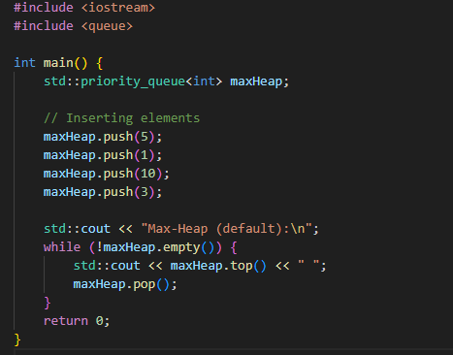


Priority Queue
Example

Slide 14
Priority Queue
Advantages of std::priority_queue
Advantage | Description
Efficient Element Management | Offers O(log n) for insertion/removal and O(1) for accessing top priority.
Dynamic Priority Maintenance | Automatically maintains heap order after each modification.
Customizability | Supports custom comparators for min-heaps or custom priority logic.
No Manual Sorting Needed | Elements are always internally sorted based on priority rules.
Memory Efficiency | Uses std::vector internally, benefiting from dynamic memory handling.
Ideal for Real-Time Prioritization | Great for scheduling, simulations, and graph algorithms like Dijkstra’s.

Slide 15
Priority Queue
Disadvantages of std::priority_queue
Disadvantage | Description
No Direct Access to Elements | You can only access the top element — no iteration or random access.
No Search or Update Support | Cannot easily find or modify a specific element in the queue.
Fixed Heap Structure | Internally uses a binary heap — cannot switch to other priority data structures (e.g., Fibonacci heap).
Limited Interface | Lacks operations like remove(element) or contains().
Cannot Store Duplicate Keys with Distinct Behavior | Handling ties or priority conflicts may require workarounds.

Slide 16
Challenges / Debugging Experience
Always use empty() before pop() or top() to avoid crashes.
Understand the behavior and limitations of each container adapter — especially their access restrictions.
Pay attention to priority rules and heap structure in std::priority_queue.
Use debug print statements strategically when dealing with abstracted containers to trace data flow.
Output was incorrect due to misunderstanding automatic reordering by priority.
Faced errors using custom comparators without correct syntax or logic.
Confused by push() adding to the back and pop() removing from the front.
Faced runtime errors by accessing front() or back() on empty queues.

Slide 17
Additional Learning Resources / Notes
CPP Reference — Comprehensive and official C++ documentation.
cplusplus.com — Beginner-friendly tutorials and examples for STL algorithms.
Containers in C++ STL | GeeksforGeeks
YouTube tutorials — Search for C++ STL algorithms and sorting tutorials.
Practice coding problems on platforms like LeetCode, Codechef.
Experiment with custom comparators to learn more about flexible sorting.

Slide 18
Q&A
Q1: What is a stack in C++ STL? A: It’s a container adapter that follows the LIFO (Last-In, First-Out) principle, allowing insertion and removal only at the top.
Q2: What is the primary use case for a queue? A: Queues follow the FIFO (First-In, First-Out) model and are ideal for processing elements in the order they arrive (e.g., task scheduling, BFS).
Q3: How does std::priority_queue determine the next element to process? A: It uses a heap structure to keep the highest-priority element at the top, which is accessed in constant time.
Q4: Can you access all elements in a std::stack or std::queue using iterators? A: No, these adapters do not support iterators — you can only access elements through top/front/back operations.
Q5: What happens if you call pop() on an empty std::queue or std::stack? A: It results in undefined behavior — always check with empty() before popping elements.

Slide 19
Plan for Tomorrow
Binary trees,
tree traversals

Slide 20
Overall Overview
Gained a clear understanding of linear data structures like stacks (LIFO) and queues (FIFO), along with non-linear structures like priority queues.
Practiced using core operations such as push(), pop(), top(), front(), and back() across different container adapters.
Explored how each container adapter provides a specialized interface over standard sequence containers like std::deque and std::vector.
Implemented real-life use cases including undo-redo functionality (stack), task processing (queue), and priority-based scheduling (priority queue).
Learned how priority queues automatically manage element order using a heap structure, ensuring fast access to the highest-priority element.
Customized priority behavior using comparators to create min-heaps or apply domain-specific sorting rules.
Understood the trade-offs between these containers, such as access restrictions in stacks and queues, and lack of iteration support in priority queues.

Slide 21


Thank You

